Slide 1




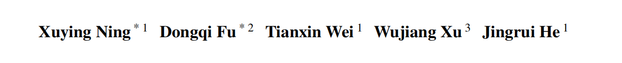





ATAI
Advanced Technique of Artificial Intelligence
ATAI
ChongqingUniversity _{AdvancedTechniqueof}
of Technology Artificial Intelligence
Chongqing University of
Technology
Chongqing University ^{ATAI}
_{of Technology} Advanced Techniqueof
Artificial Intelligence
Chongqing University of Technology
Chongqing University of Technology
Graph4MM: Weaving Multimodal Learning
with Structural Information
Code: https://github.com/YennNing/Graph4MM
—ICML_2025
Reported by Cong Sheng
1

Slide 2
ATAI
Advanced Technique of Artificial Intelligence
ATAI
ChongqingUniversity _{AdvancedTechniqueof}
of Technology Artificial Intelligence
Chongqing University of
Technology
Chongqing University ^{ATAI}
_{of Technology} Advanced Techniqueof
Artificial Intelligence
Chongqing University of Technology
Chongqing University of Technology
Motivation
Treating graph structure as an independent modality, parallel to text and image inputs, leads to difficulties in semantic alignment.
Ignoring differences among multi-hop neighbors in the graph prevents effective utilization of long-range structural information.
Graph neural networks (e.g., GCN, GAT) exhibit limited performance in multimodal generation and reasoning tasks and are prone to over-smoothing.

Slide 3
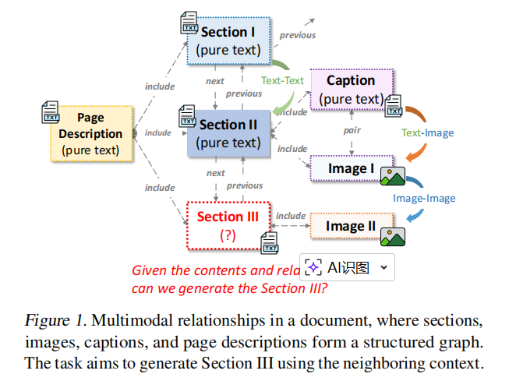
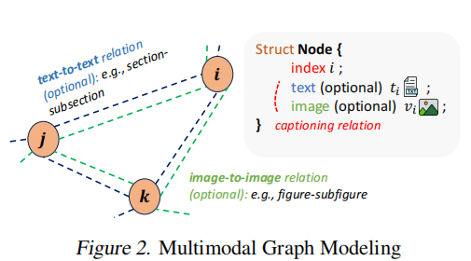
ATAI
Advanced Technique of Artificial Intelligence
ATAI
ChongqingUniversity _{AdvancedTechniqueof}
of Technology Artificial Intelligence
Chongqing University of
Technology
Chongqing University ^{ATAI}
_{of Technology} Advanced Techniqueof
Artificial Intelligence
Chongqing University of Technology
Chongqing University of Technology
Overview

Slide 4
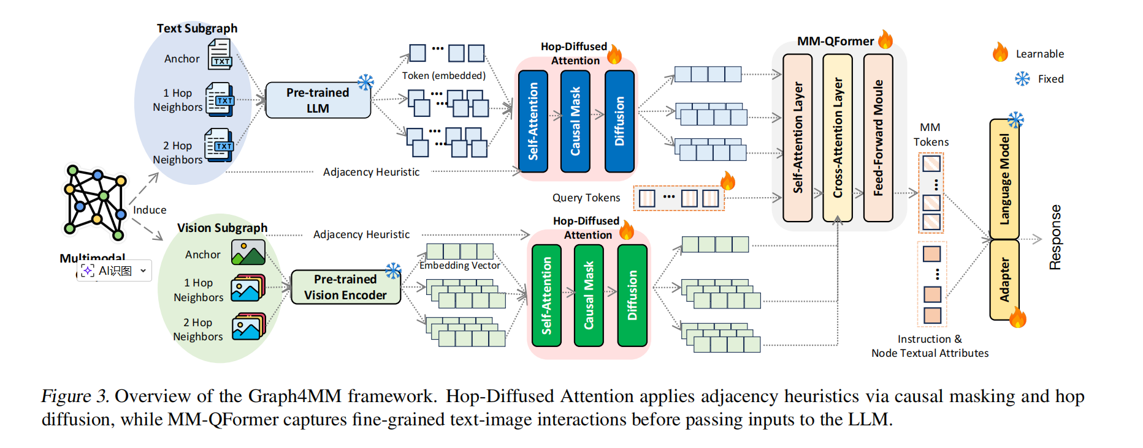
ATAI
Advanced Technique of Artificial Intelligence
ATAI
ChongqingUniversity _{AdvancedTechniqueof}
of Technology Artificial Intelligence
Chongqing University of
Technology
Chongqing University ^{ATAI}
_{of Technology} Advanced Techniqueof
Artificial Intelligence
Chongqing University of Technology
Chongqing University of Technology
Overview

Slide 5
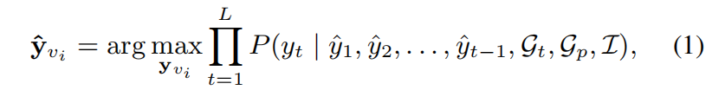







ATAI
Advanced Technique of Artificial Intelligence
ATAI
ChongqingUniversity _{AdvancedTechniqueof}
of Technology Artificial Intelligence
Chongqing University of
Technology
Chongqing University ^{ATAI}
_{of Technology} Advanced Techniqueof
Artificial Intelligence
Chongqing University of Technology
Chongqing University of Technology
Method

Slide 6





ATAI
Advanced Technique of Artificial Intelligence
ATAI
ChongqingUniversity _{AdvancedTechniqueof}
of Technology Artificial Intelligence
Chongqing University of
Technology
Chongqing University ^{ATAI}
_{of Technology} Advanced Techniqueof
Artificial Intelligence
Chongqing University of Technology
Chongqing University of Technology
Method

Slide 7






ATAI
Advanced Technique of Artificial Intelligence
ATAI
ChongqingUniversity _{AdvancedTechniqueof}
of Technology Artificial Intelligence
Chongqing University of
Technology
Chongqing University ^{ATAI}
_{of Technology} Advanced Techniqueof
Artificial Intelligence
Chongqing University of Technology
Chongqing University of Technology
Method

Slide 8






ATAI
Advanced Technique of Artificial Intelligence
ATAI
ChongqingUniversity _{AdvancedTechniqueof}
of Technology Artificial Intelligence
Chongqing University of
Technology
Chongqing University ^{ATAI}
_{of Technology} Advanced Techniqueof
Artificial Intelligence
Chongqing University of Technology
Chongqing University of Technology
Method

Slide 9





ATAI
Advanced Technique of Artificial Intelligence
ATAI
ChongqingUniversity _{AdvancedTechniqueof}
of Technology Artificial Intelligence
Chongqing University of
Technology
Chongqing University ^{ATAI}
_{of Technology} Advanced Techniqueof
Artificial Intelligence
Chongqing University of Technology
Chongqing University of Technology
Method

Slide 10
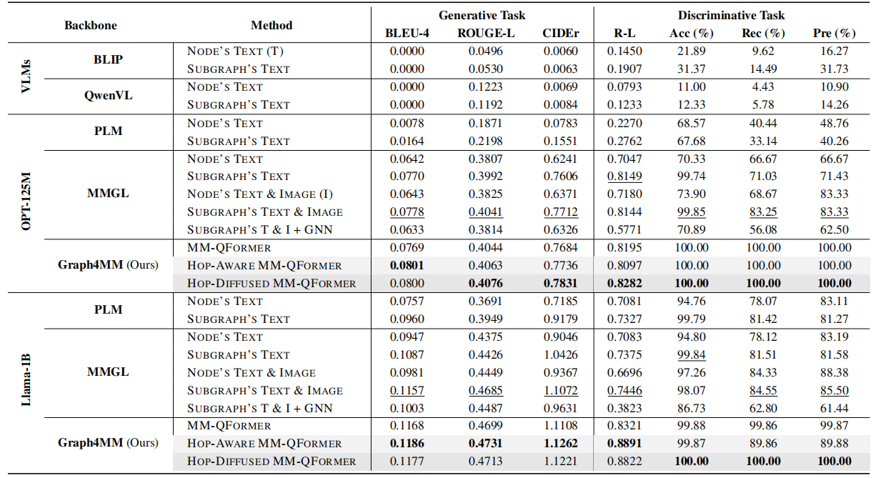
ATAI
Advanced Technique of Artificial Intelligence
ATAI
ChongqingUniversity _{AdvancedTechniqueof}
of Technology Artificial Intelligence
Chongqing University of
Technology
Chongqing University ^{ATAI}
_{of Technology} Advanced Techniqueof
Artificial Intelligence
Chongqing University of Technology
Chongqing University of Technology
Experiments

Slide 11
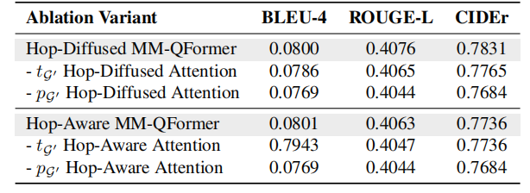
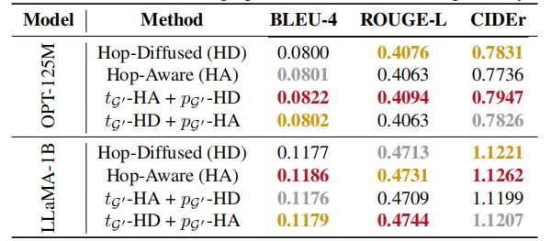
ATAI
Advanced Technique of Artificial Intelligence
ATAI
ChongqingUniversity _{AdvancedTechniqueof}
of Technology Artificial Intelligence
Chongqing University of
Technology
Chongqing University ^{ATAI}
_{of Technology} Advanced Techniqueof
Artificial Intelligence
Chongqing University of Technology
Chongqing University of Technology
Experiments

Slide 12

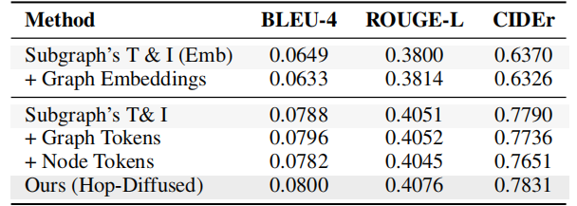
ATAI
Advanced Technique of Artificial Intelligence
ATAI
ChongqingUniversity _{AdvancedTechniqueof}
of Technology Artificial Intelligence
Chongqing University of
Technology
Chongqing University ^{ATAI}
_{of Technology} Advanced Techniqueof
Artificial Intelligence
Chongqing University of Technology
Chongqing University of Technology

